Slide 1
Old car price prediction
Presented by- Anusika rani
Learn & build (week 2 project)
Arka jain university

Slide 2
Introduction / approach
In this model the dataset given had some missing values for which some pre-processing and data cleaning like dropping some columns was performed.
Then EDA was performed to find the highest-selling car through different parametric comparisons.
Then the prediction model was made by splitting the training and testing data.
Then different regression models were applied to find the most suitable one.

Slide 3
Findings after reading and exploring dataset
Cars’ seat range is 0-10 (Seats with 0)!
There are two units of Mileage!
Remove CC && PHP
New Price contains many Nans
When doing data prediction (Engine, Mileage, and Power) types must be changed
Owner Type Must be changed to be predicted
Name will be more understandable ( Brand, Model)

Slide 4
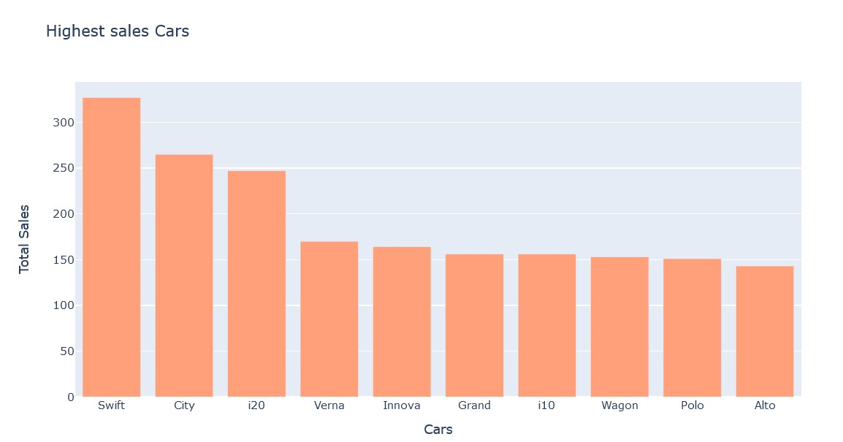
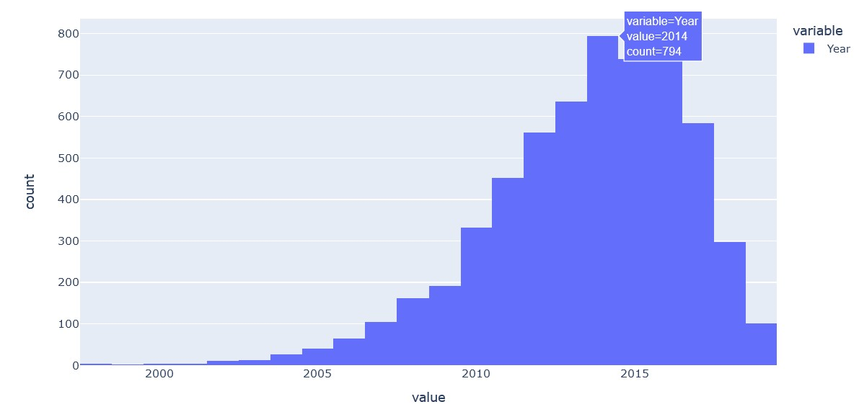
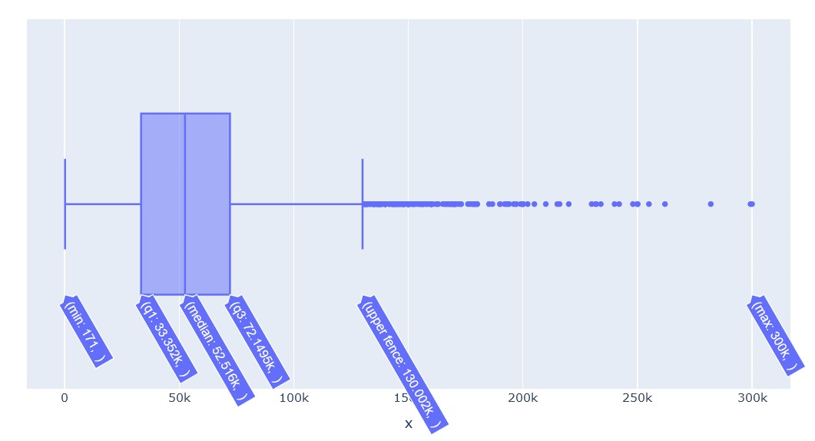
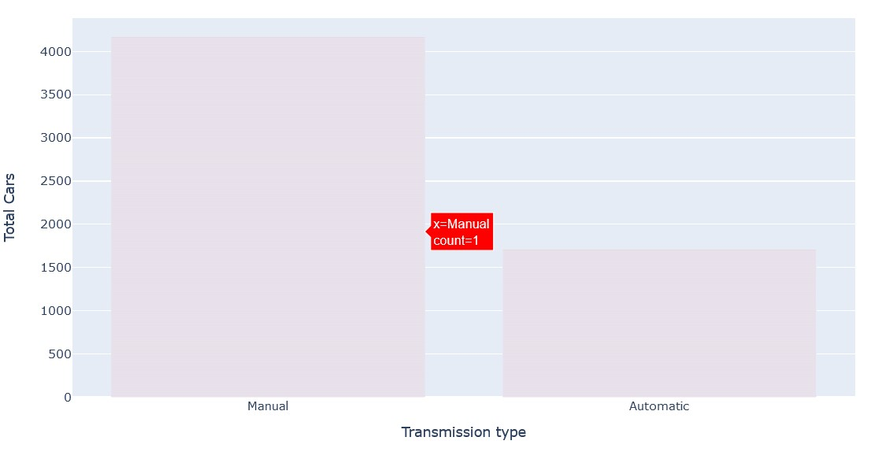
Exploratory Data Analysis findings

Slide 5
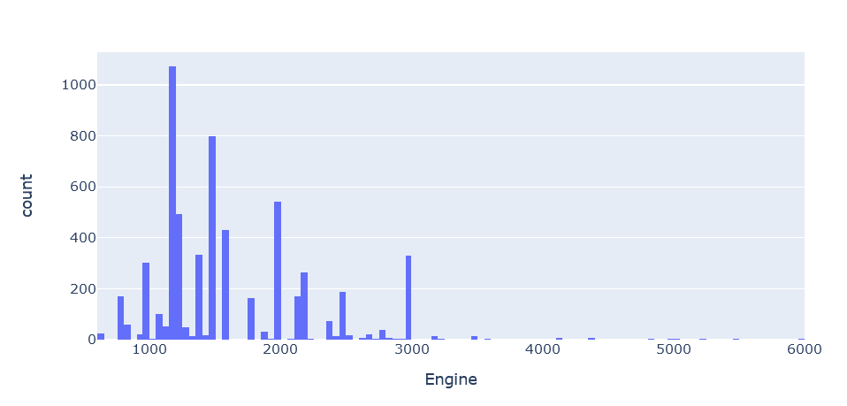
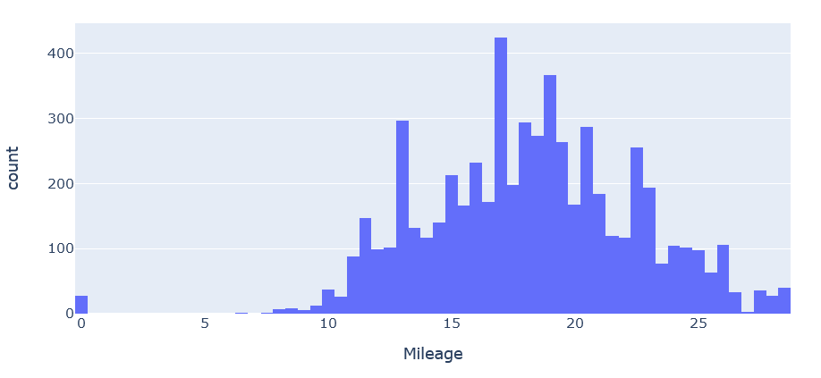
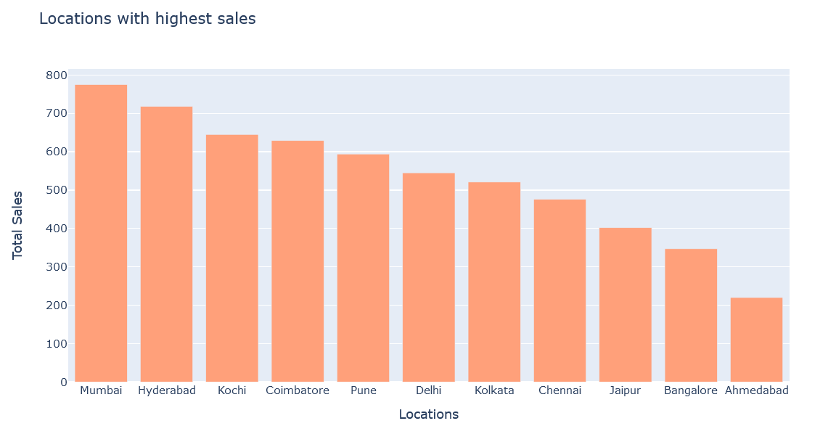
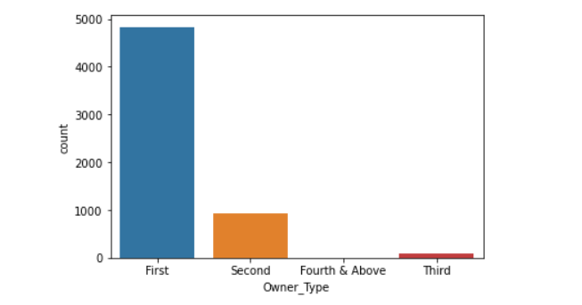

Slide 6
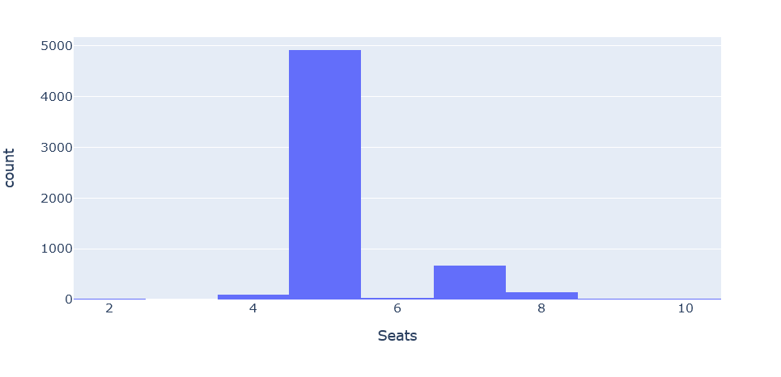
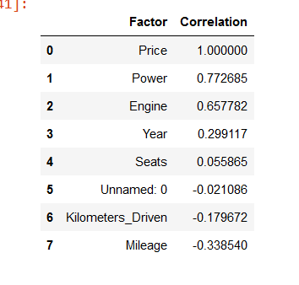
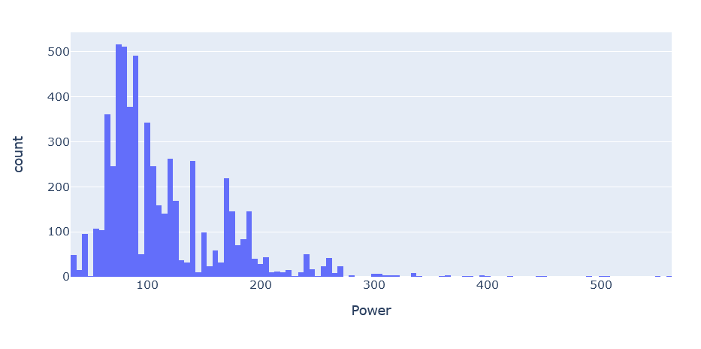

Slide 7
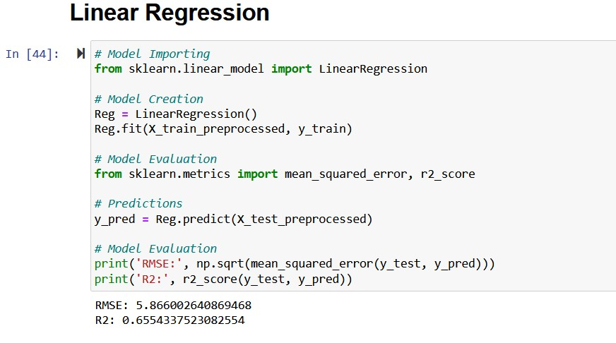
Linear Regression

Slide 8
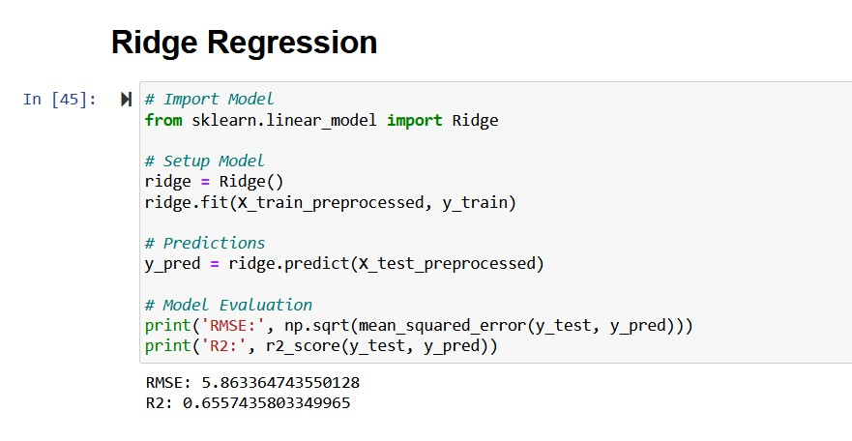
Ridge Regression

Slide 9
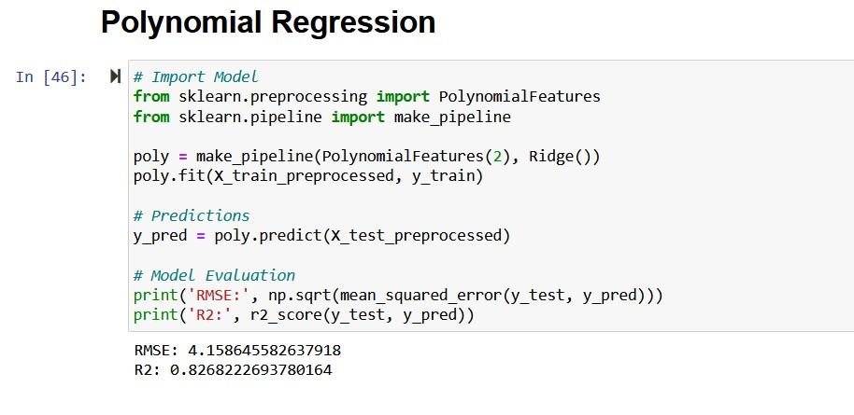
Polynomial Regression

Slide 10
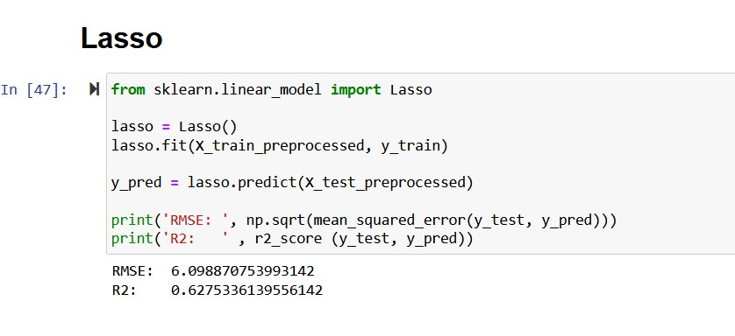
Lasso

Slide 11
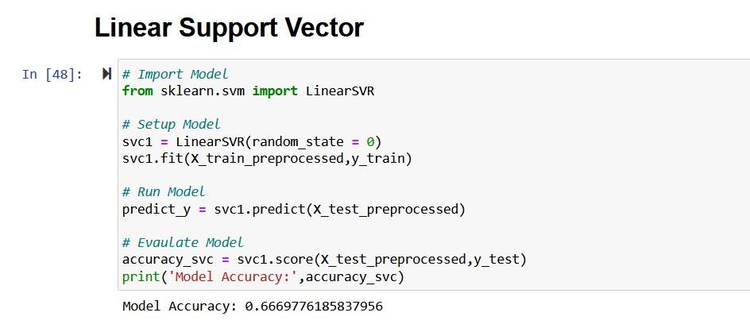
Linear Support Vector

Slide 12
conclusion
Polynomial regression performs most accurately among all the algorithms tested, thus the best-fitting model.
The R2 score being – 0.8268222693780164
RMSE being – 4.158645582637918

